Slide 1
Predicting the thermodynamic effect of mutations on a genome-wide scale
Alexey Strokach

Slide 2
Overview
Introduction
Rise in genome sequencing
Difficulty in interpreting discovered variants
ELASPIC (Berliner et al. 2014)
Implementation
Domain definitions
Database backend
ELASPIC pipeline and CLI
Precalculating data
ELASPIC REST API
Results
Grid-search (to find a good set of parameters)
Feature elimination
Discussion
What have we learned?
Future directions
Future directions
Better features / model
More training data

Slide 3
Introduction

Slide 4
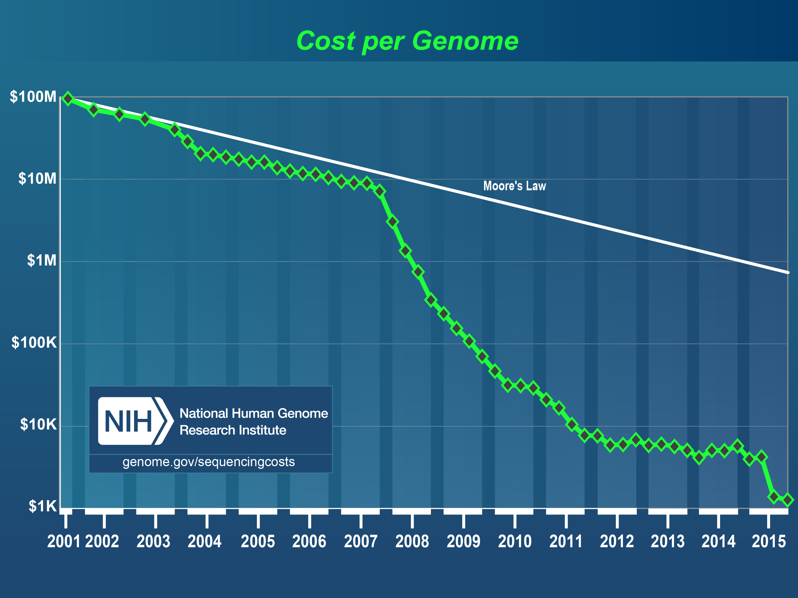
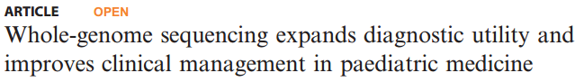
Introduction - Rise in genome sequening
Cost of genome sequencing has fallen dramatically.
Interpreting genomic variants to yield meaningful and actionable results remains a challenge.
https://www.genome.gov/27541954/dna-sequencing-costs-data/

Slide 5
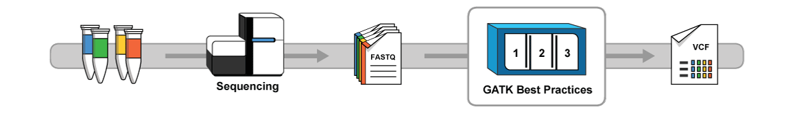
Introduction - Variant calling / scoring
Variant calling
https://software.broadinstitute.org/gatk/
Notes:
We are all going to hell in a bread basket.

Slide 6
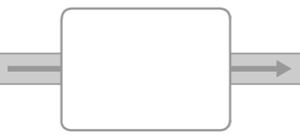






Introduction - Variant calling / scoring
Variant calling
https://software.broadinstitute.org/gatk/
Variant scoring
# chr position ref alt...
SIFT
Provean
GERP++
etc...
dbNSFP
Notes:
We are all going to hell in a bread basket.

Slide 7
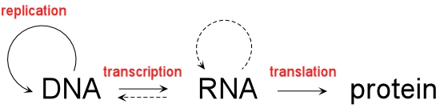
Introduction - Variant analysis
Notes:
All happy families are alike; each unhappy family is unhappy in its own way. -> "In what way is the great big family of proteins unhappy in each person, and what can we do make them happy?"

Slide 8

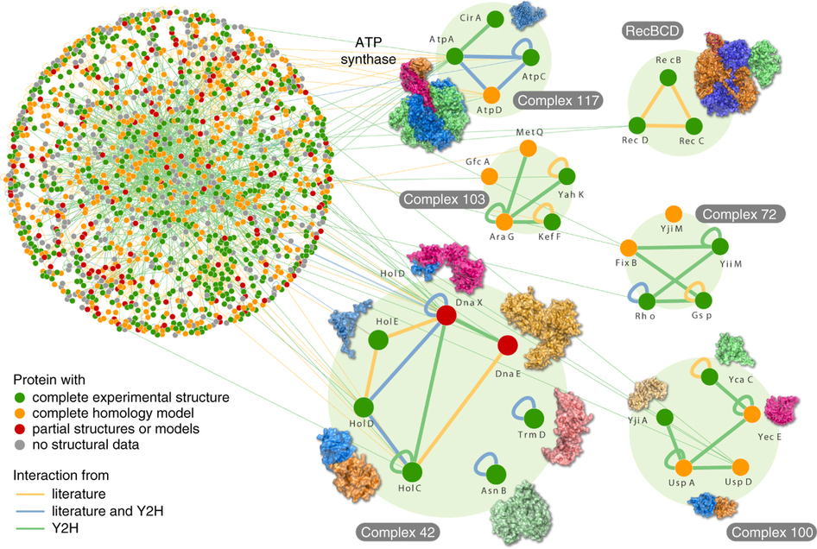

Introduction - Variant analysis
Variant interpretation
Rajagopala S. et al., Nature Biotech., 2014.
Notes:
All happy families are alike; each unhappy family is unhappy in its own way. -> "In what way is the great big family of proteins unhappy in each person, and what can we do make them happy?"

Slide 9
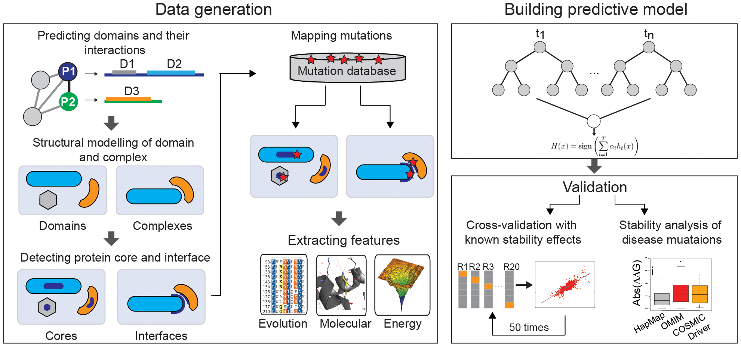
Introduction - Variant analysis
ELASPIC (Berliner et al. 2014)

Slide 10
Introduction - Goals
Goals
Extend ELASPIC to work on a genome-wide scale
Profs for domain definitions
Use programs that work for most sequences / structures
Implement ELASPIC as a back-end to a webserver
Demonstrate the usefullness of ELASPIC in providing meaningful and actionable information about mutations.

Slide 11
Implementation

Slide 12
Implementation
Domain definitions
Profs (Andres Felipe Giraldo-Forero)
Domain-domain interactions
Database backend
ELASPIC pipeline + CLI interface
Precalculate Provean, homology models, and many mutations
Webservice for submitting and monitoring jobs

Slide 13
Implementation - Domain definitions

Slide 14
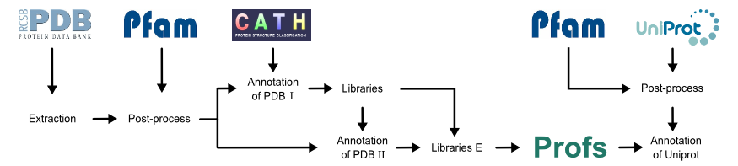
Implementation - Domain definitions
(3)
(1)
(2)
(4)
(5)
(6)
Andres Felipe Giraldo Forero

Slide 15
Implementation - Domain definitions
(3)
(1)
(2)
(4)
(5)
(6)
Pfam
Pfam supradomains
Final Profs BLAST libraries
Profs
Profs Clan A
Profs Clan C
…
…
Profs Clan B
Profs Clan D
…
…
64+ million Pfam domains
57+ million Pfam supradomains
42+ million (74%) Profs domains
Notes:
Pfam domain definitions from SIMAP.

Slide 16
Implementation - Domain interactions
(3)
(1)
(2)
(4)
(5)
(6)
Profs
Profs
Final Profs BLAST libraries
Profs Domain Pairs
PPI
Profs Clan A
Profs Clan C
Profs Clan B
Profs Clan D
…
…
…
…
…
42+ million Profs domains
42+ million Profs domains
466,010 domain pairs with structural templates
9+ million possible domain-domain combinations (mostly human)

Slide 17

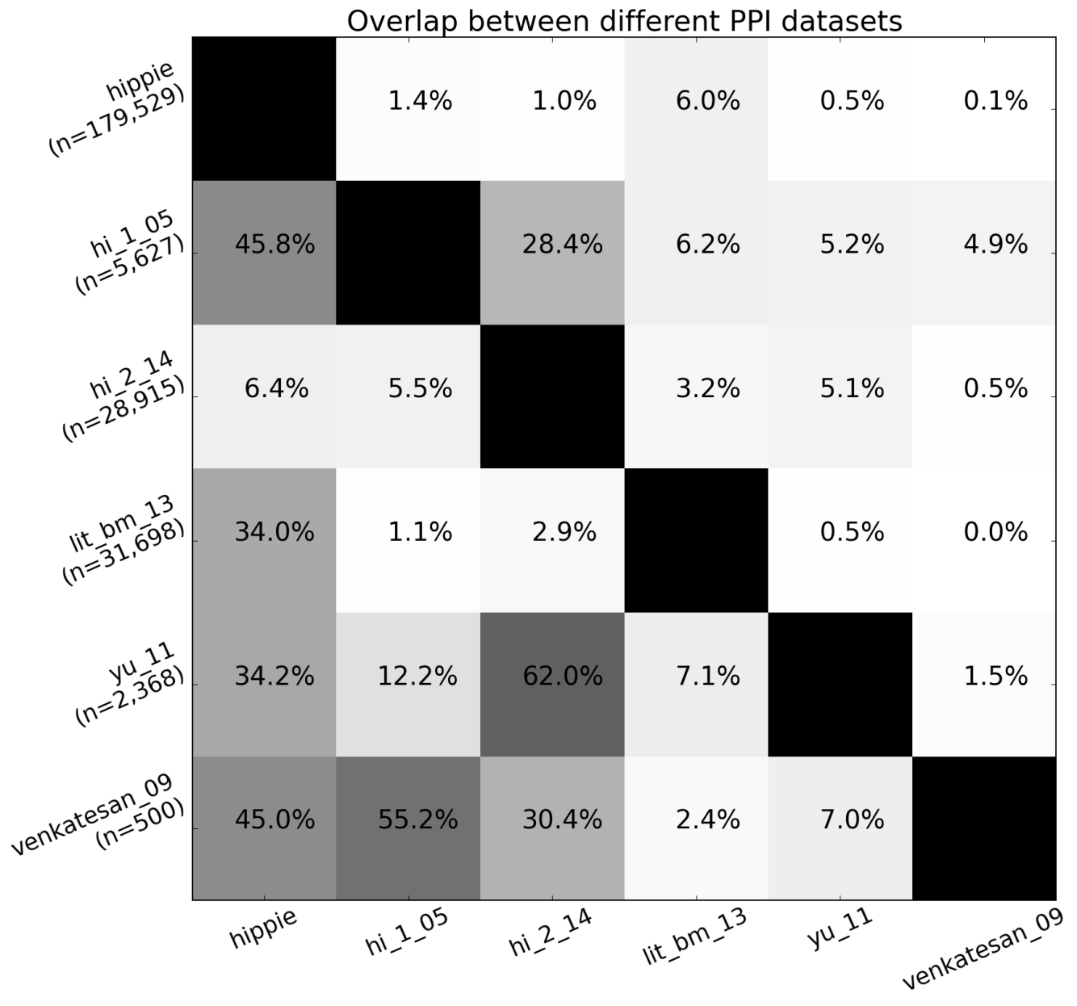
Implementation - Protein interactions
HIPPIE: Integrating Protein Interaction Networks with Experiment Based Quality Scores, Schaefer et al., PLOS ONE, 2012
A Human Protein-Protein Interaction Network: A Resource for Annotating the Proteome, Stelzl et al., Cell, 2005
A proteome-scale map of the human interactome network, Rolland et al., Cell, 2014

Slide 18
Implementation - Database backend

Slide 19
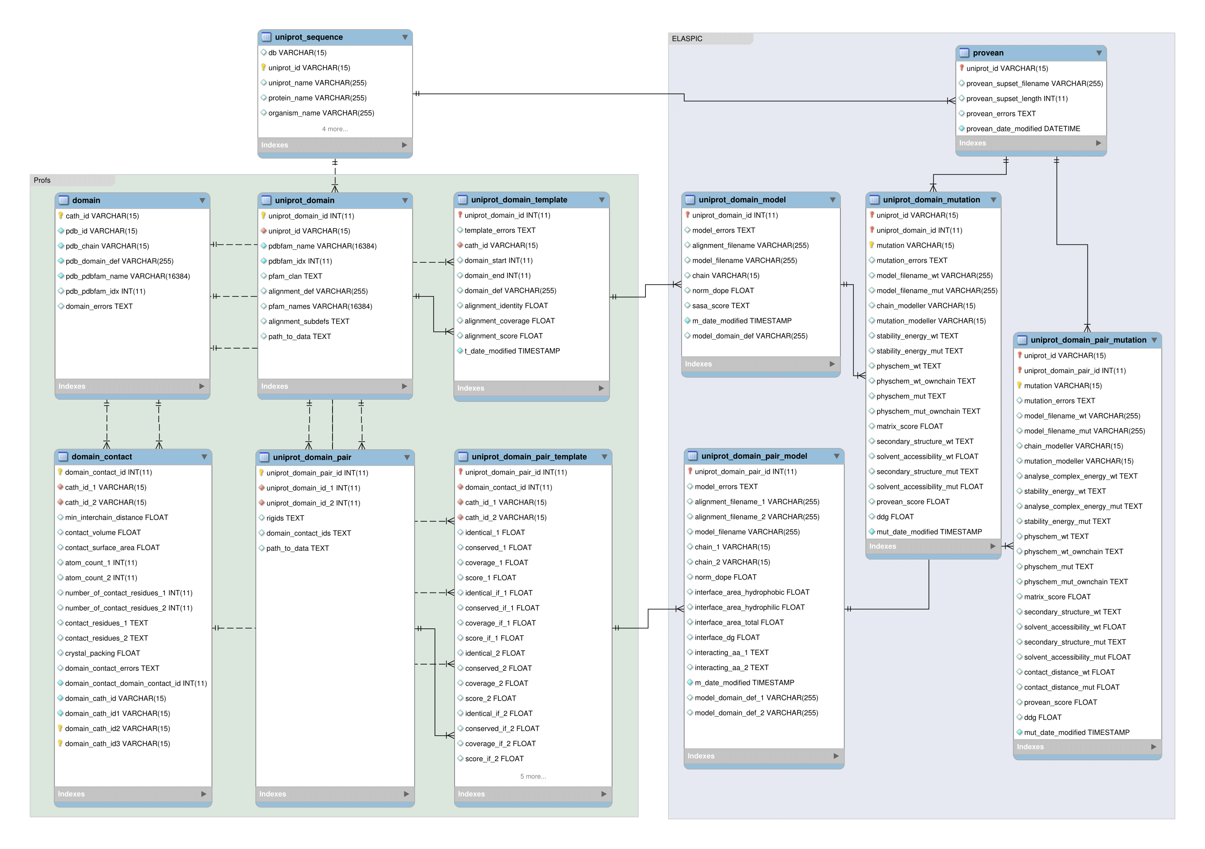
Implementation - Database backend

Slide 20
Implementation - ELASPIC pipeline and CLI

Slide 21
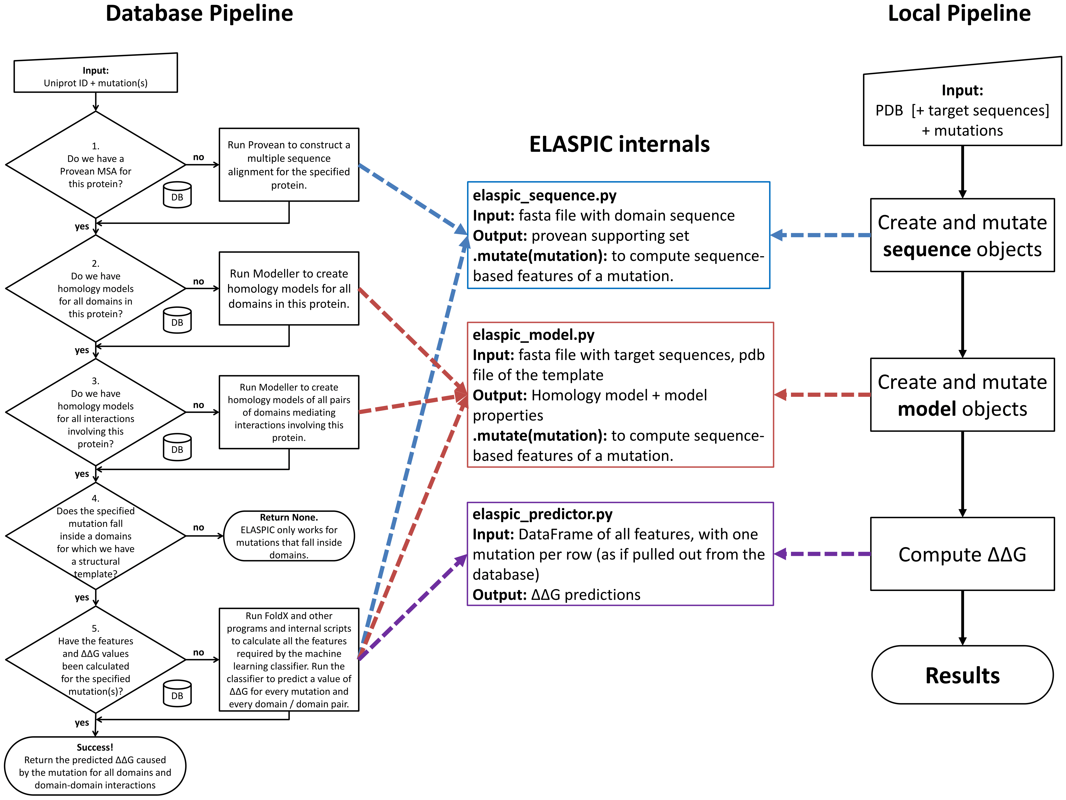
Implementation - ELASPIC pipeline and CLI

Slide 22
Implementation - Precalculated data

Slide 23
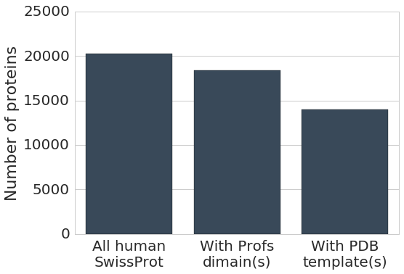
Implementation - Precalculated data
Found structural templates

Slide 24
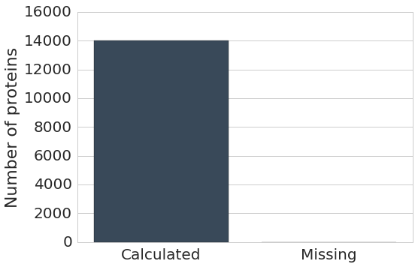
Implementation - Precalculated data
Precalculated Provean

Slide 25
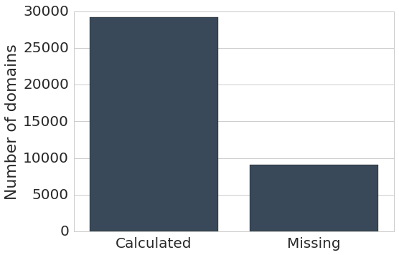
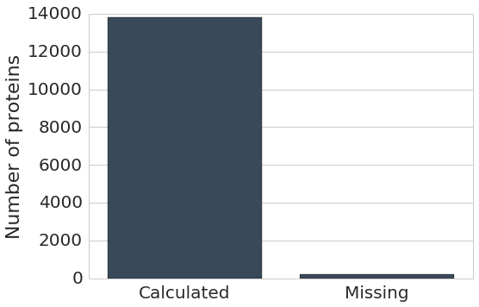
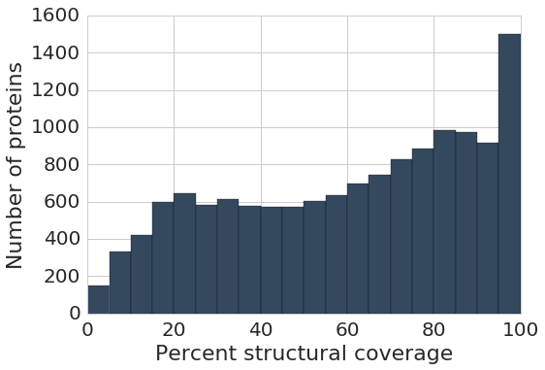
Implementation - Precalculated data
Precalculated domains
Precalculated at least one model
Structural coverage for proteins with at least one model

Slide 26
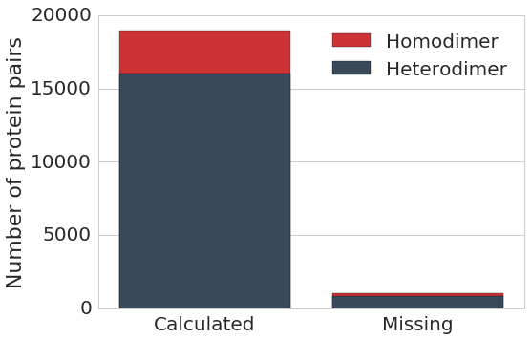
Implementation - Precalculated data
Precalculated interfaces (excluding splice variants)

Slide 27
Implementation - Precalculated data
991,533 core mutations
593,106 interface mutations
Includes mutations from popular databases such as UniProt (humsavar.txt), ClinVar, COSMIC.

Slide 28
Implementation - Webservice
Notes:
If you are familiar with Node.JS, this will not be new. This is how Node does everything.

Slide 29
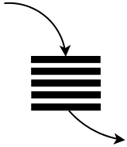


Implementation - Webservice
Asyncronous web server for submitting and monitoring ELASPIC jobs.
Can have thousands of mutations, so having a thread monitoring each mutation would not be a good design.
Need to update job status to "done" when all mutations are done, in order to send the "Job complete" email.
No blocking calls!
Submit and monitor Provean jobs.
Requests, etc.
Event loop
Job status
Submit and monitor homology modelling jobs.
Submit and monitor mutation jobs.
Python 3.5 + aiohttp
Notes:
If you are familiar with Node.JS, this will not be new. This is how Node does everything.

Slide 30
Results

Slide 31
Results
Core mutation predictor
Retrain core predictor
Feature elimination to thrown away unimportant features
Validate on an independent, non-overlapping datataset
Interface mutation predictor
Retrain core predictor
Feature elimination to thrown away unimportant features
Validate on an independent, non-overlapping datataset

Slide 32
Results - Datasets
Training:
Protherm: Database of changes in the Gibbs free energy of protein folding caused by mutations.
Skempi: Database of changes in the Gibbs free energy of protein folding caused by mutations.
Training / Validation:
Taipale: Chaperone interaction assay measuring protein stability.
Taipale PPI: "Yiest two hybrid studies measuring the effect of mutations on the presence / abscence of interactions."
Taipale GPCA: "Gaussia princeps luciferase protein complementation assay" measuring the effect of mutations on protein affinity.
Test:
Humsavar: Disease-causing mutations vs. polymorphisms. Mostly OMIM, old ClinVar, old COSMIC.
Clinvar: Disease-causing mutations with a weaker inheritence link than OMIM.
COSMIC: Mutations found in cancers. Use high-confidence FATHMM predictions.
SUMO Ligase: Mutations affecting the activity of SUMO ligase, measured using a cell viability assey.
AB-Bind: Antibody affinity maturation experiments.
Benedix et al.: Alanine scanning of the TEM1-BLIP (β-lactamase - β-lactamase-inhibitor) complex.

Slide 33
Results - Core predictor

Slide 34
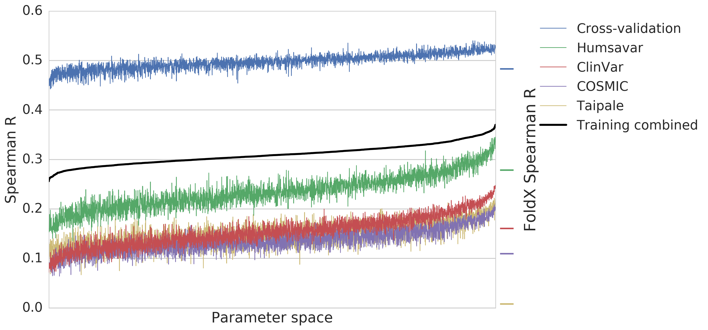
Results - Core parameter search
Training combined = 3 × Cross-validation +
1 × (Humsavar + ClinVar + COSMIC) +
1 × Taipale

Slide 35
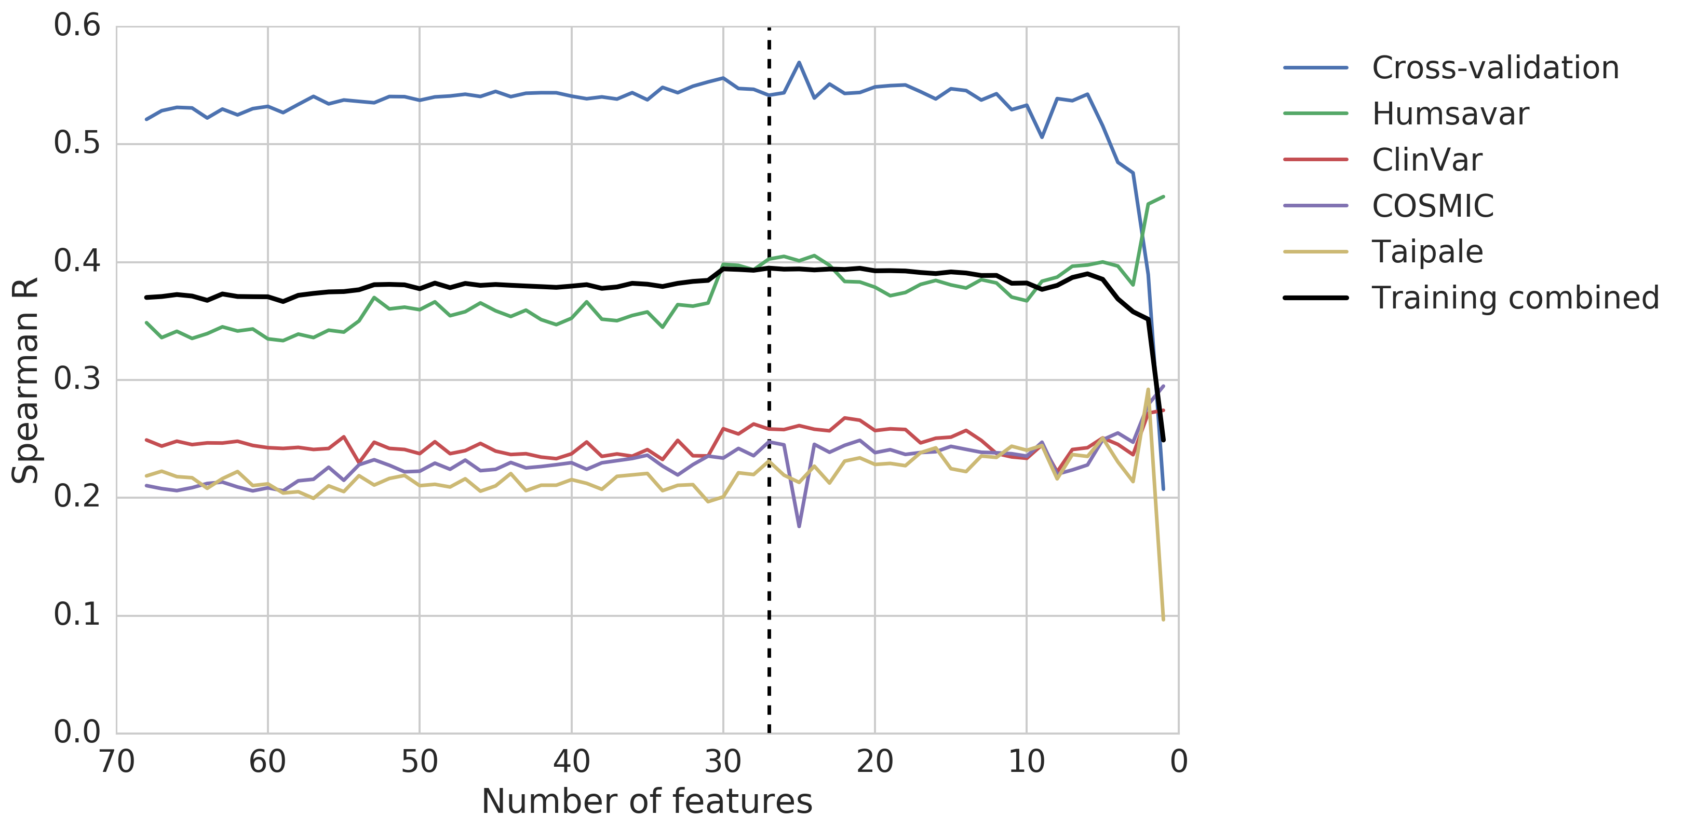
Results - Core feature elimination
Training combined = 3 × Cross-validation +
1 × (Humsavar + ClinVar + COSMIC) +
1 × Taipale

Slide 36
Results - Core important features
Feature name | Feature description | * / **
alignment_coverage | Alignment quality
alignment_identity | Alignment quality
alignment_score | Alignment quality
backbone_hbond_change | FoldX
backbone_hbond_wt | FoldX
cis_bond_wt | FoldX
disulfide_wt | FoldX
electrostatic_kon_change | FoldX
electrostatics_change | FoldX | *
entropy_mainchain_change | FoldX
helix_dipole_wt | FoldX
matrix_score | Sequence conservation
pcv_hbond_change | Physico-chemical features
pcv_hbond_self_change | Physico-chemical features
pcv_salt_equal_change | Physico-chemical features
pcv_salt_equal_self_wt | Physico-chemical features
pcv_salt_equal_wt | Physico-chemical features
pcv_salt_opposite_change | Physico-chemical features
pcv_vdw_self_change | Physico-chemical features
provean_score | Sequence conservation | **
sloop_entropy_wt | FoldX
solvation_hydrophobic_change | FoldX | *
solvation_polar_change | FoldX | **
solvent_accessibility_wt | FoldX | *
torsional_clash_change | FoldX
van_der_waals_clashes_change | FoldX | *
water_bridge_wt | FoldX
* top 6 ** top 6 interface

Slide 37
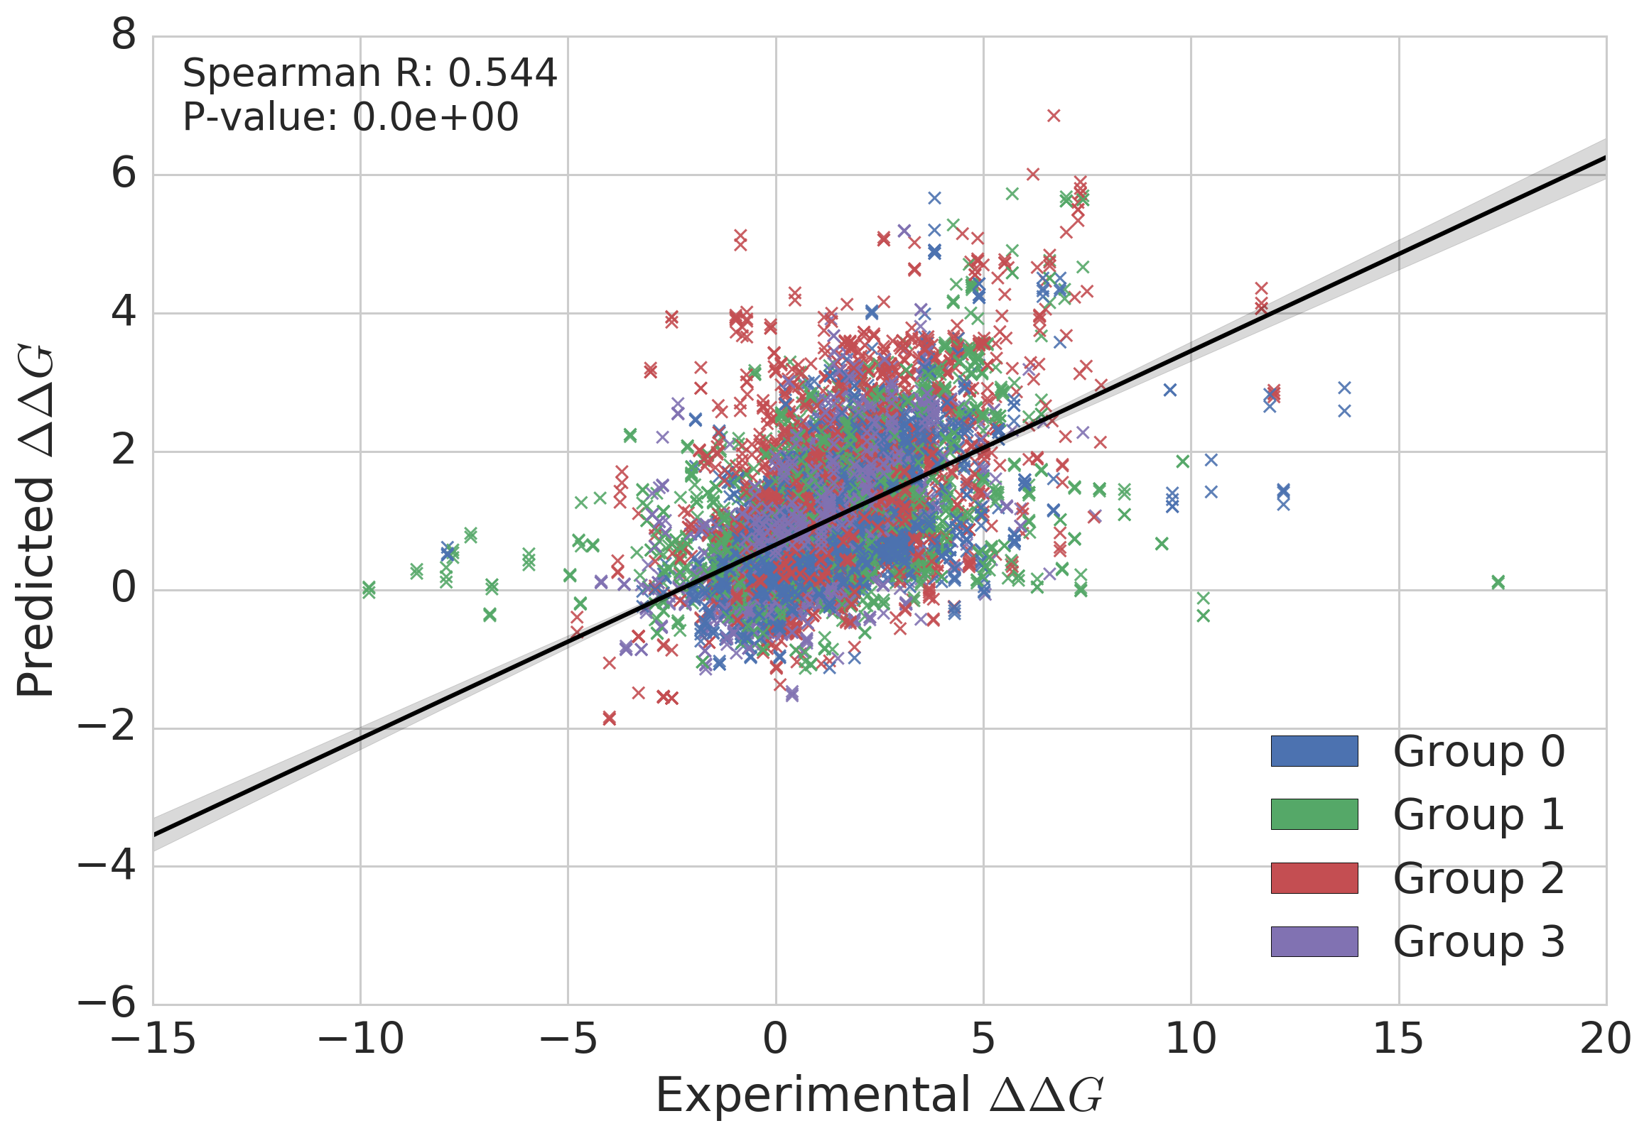
Results - Core cross-validation

Slide 38
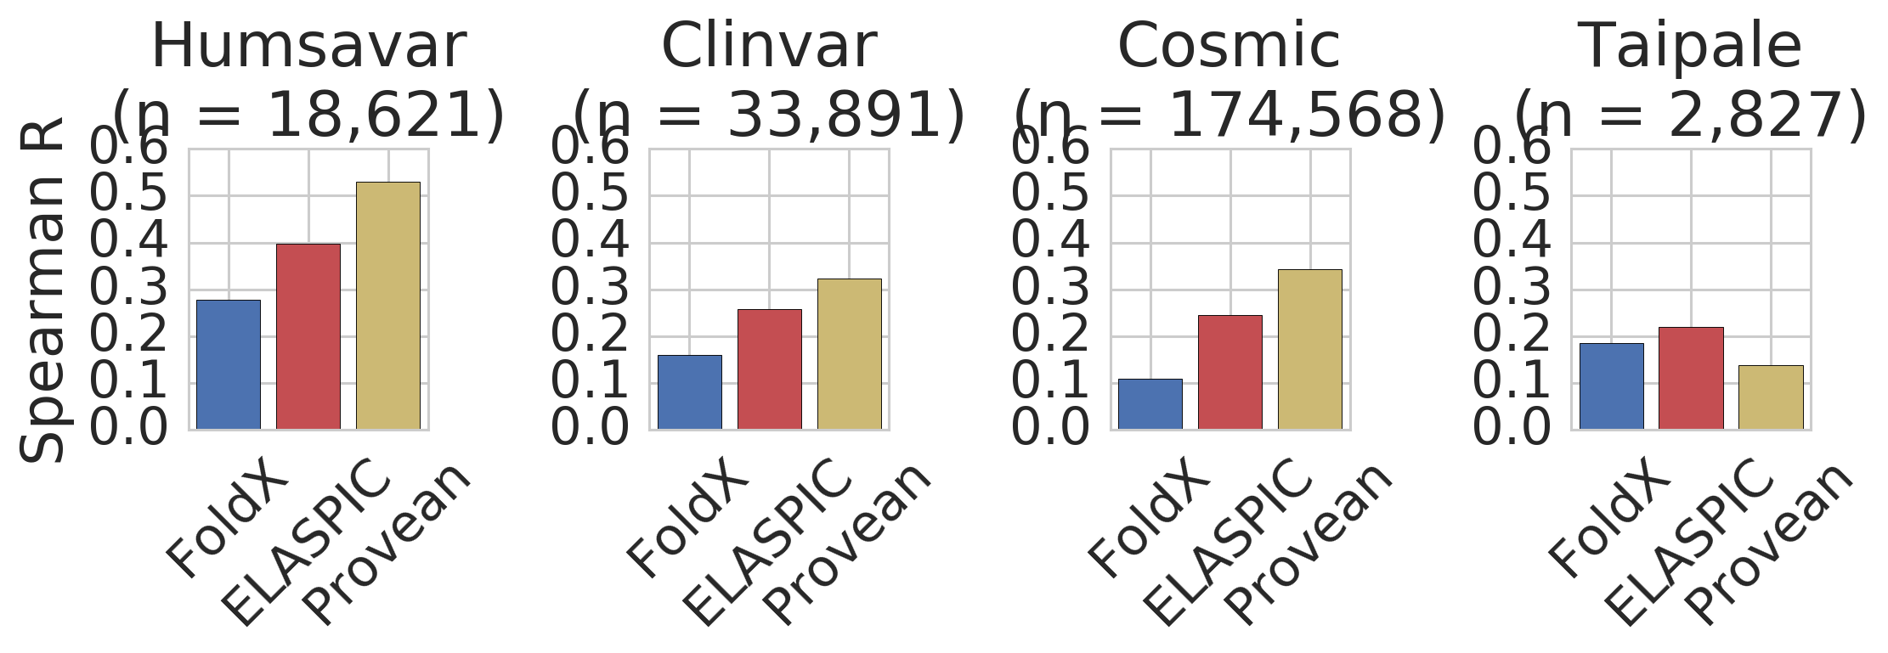
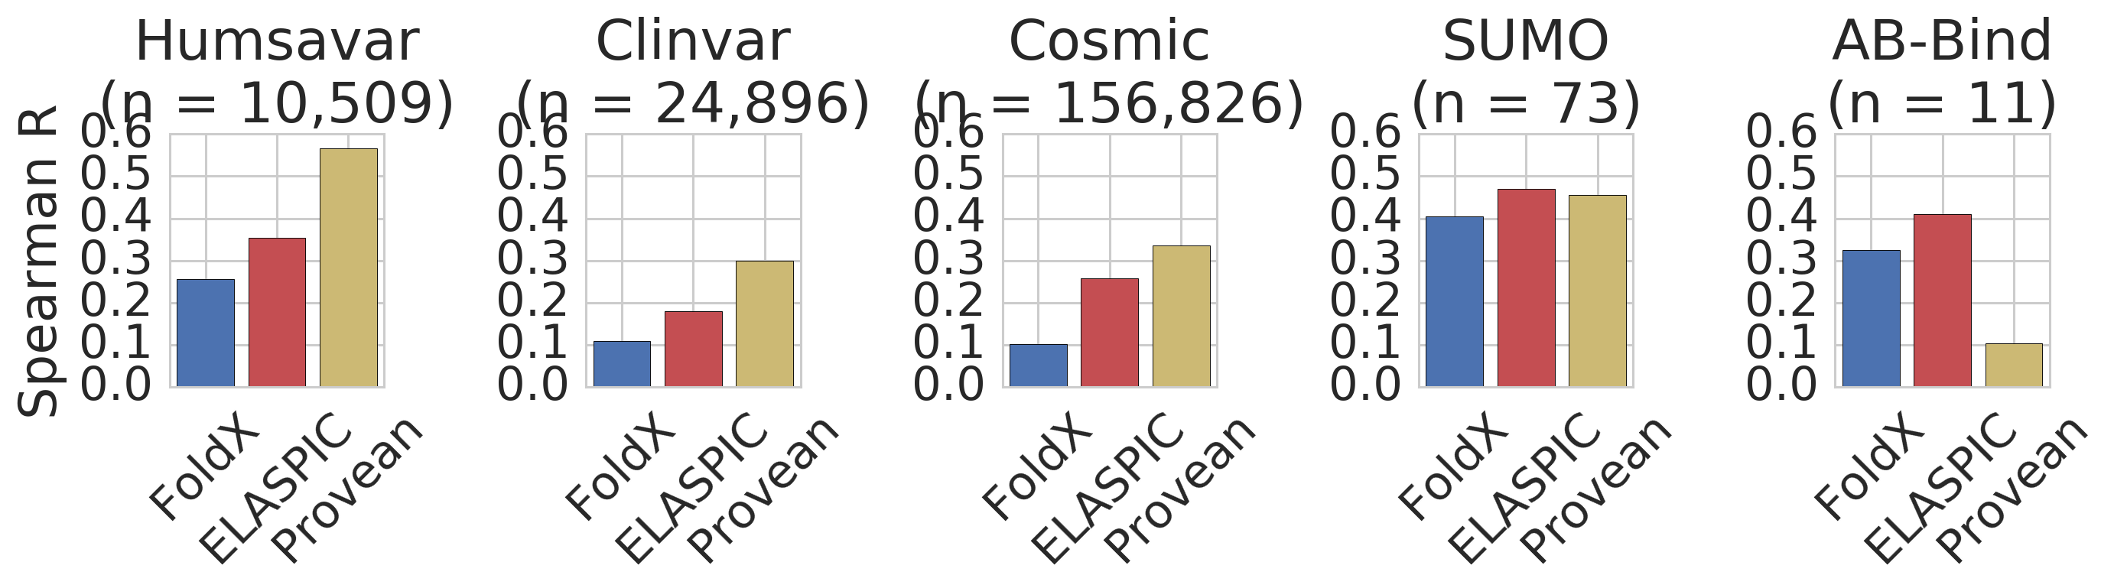
Results - Core validation/test performance

Slide 39
Results - Interface predictor

Slide 40
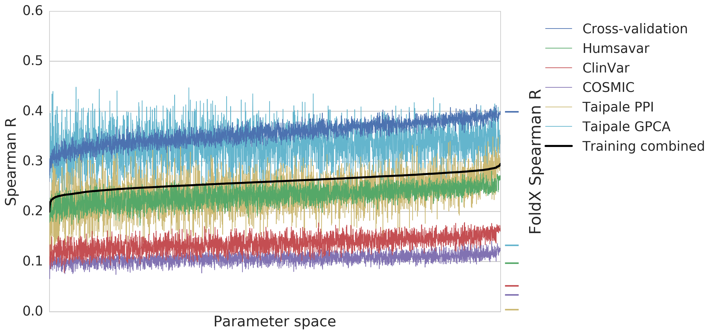
Results - Interface parameter search
Training combined = 3 × Cross-validation +
1 × (Humsavar + ClinVar + COSMIC) +
1/4 × (Taipale PPI + Taipale GPCA)

Slide 41
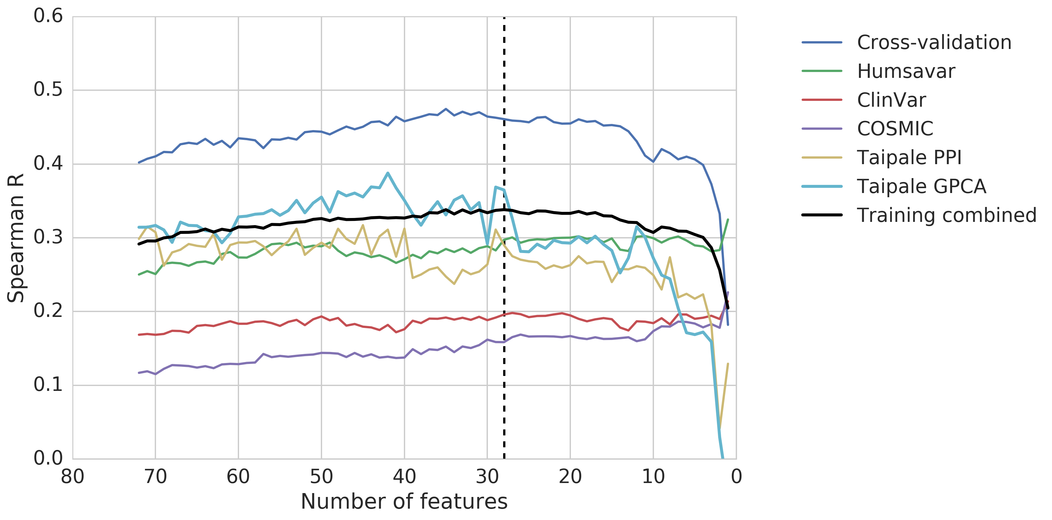
Results - Interface feature elimination
Training combined = 3 × Cross-validation +
1 × (Humsavar + ClinVar + COSMIC) +
1/4 × (Taipale PPI + Taipale GPCA)

Slide 42
Results - Interface important features
Feature name | Feature description | * / **
alignment_score | Alignment quality
backbone_clash_change | FoldX
backbone_clash_wt | FoldX
backbone_hbond_change | FoldX
cis_bond_wt | FoldX
electrostatic_kon_wt | FoldX
energy_ionisation_wt | FoldX
entropy_complex_change | FoldX
entropy_sidechain_change | FoldX | *
intraclashes_energy_2_change | FoldX
partial_covalent_bonds_wt | FoldX | *
pcv_hbond_self_change | Physico-chemical features
pcv_hbond_wt | Physico-chemical features
pcv_salt_equal_self_change | Physico-chemical features
pcv_salt_equal_wt | Physico-chemical features
pcv_salt_opposite_change | Physico-chemical features
pcv_salt_opposite_self_change | Physico-chemical features
pcv_salt_opposite_self_wt | Physico-chemical features
pcv_vdw_self_change | Physico-chemical features
pcv_vdw_self_wt | Physico-chemical features | *
pcv_vdw_wt | Physico-chemical features | *
provean_score | Sequence conservation | **
sloop_entropy_change | FoldX
solvation_hydrophobic_change | FoldX
solvation_polar_change | FoldX | **
solvation_polar_wt | FoldX
torsional_clash_change | FoldX
water_bridge_change | FoldX
* top 6 ** top 6 core

Slide 43
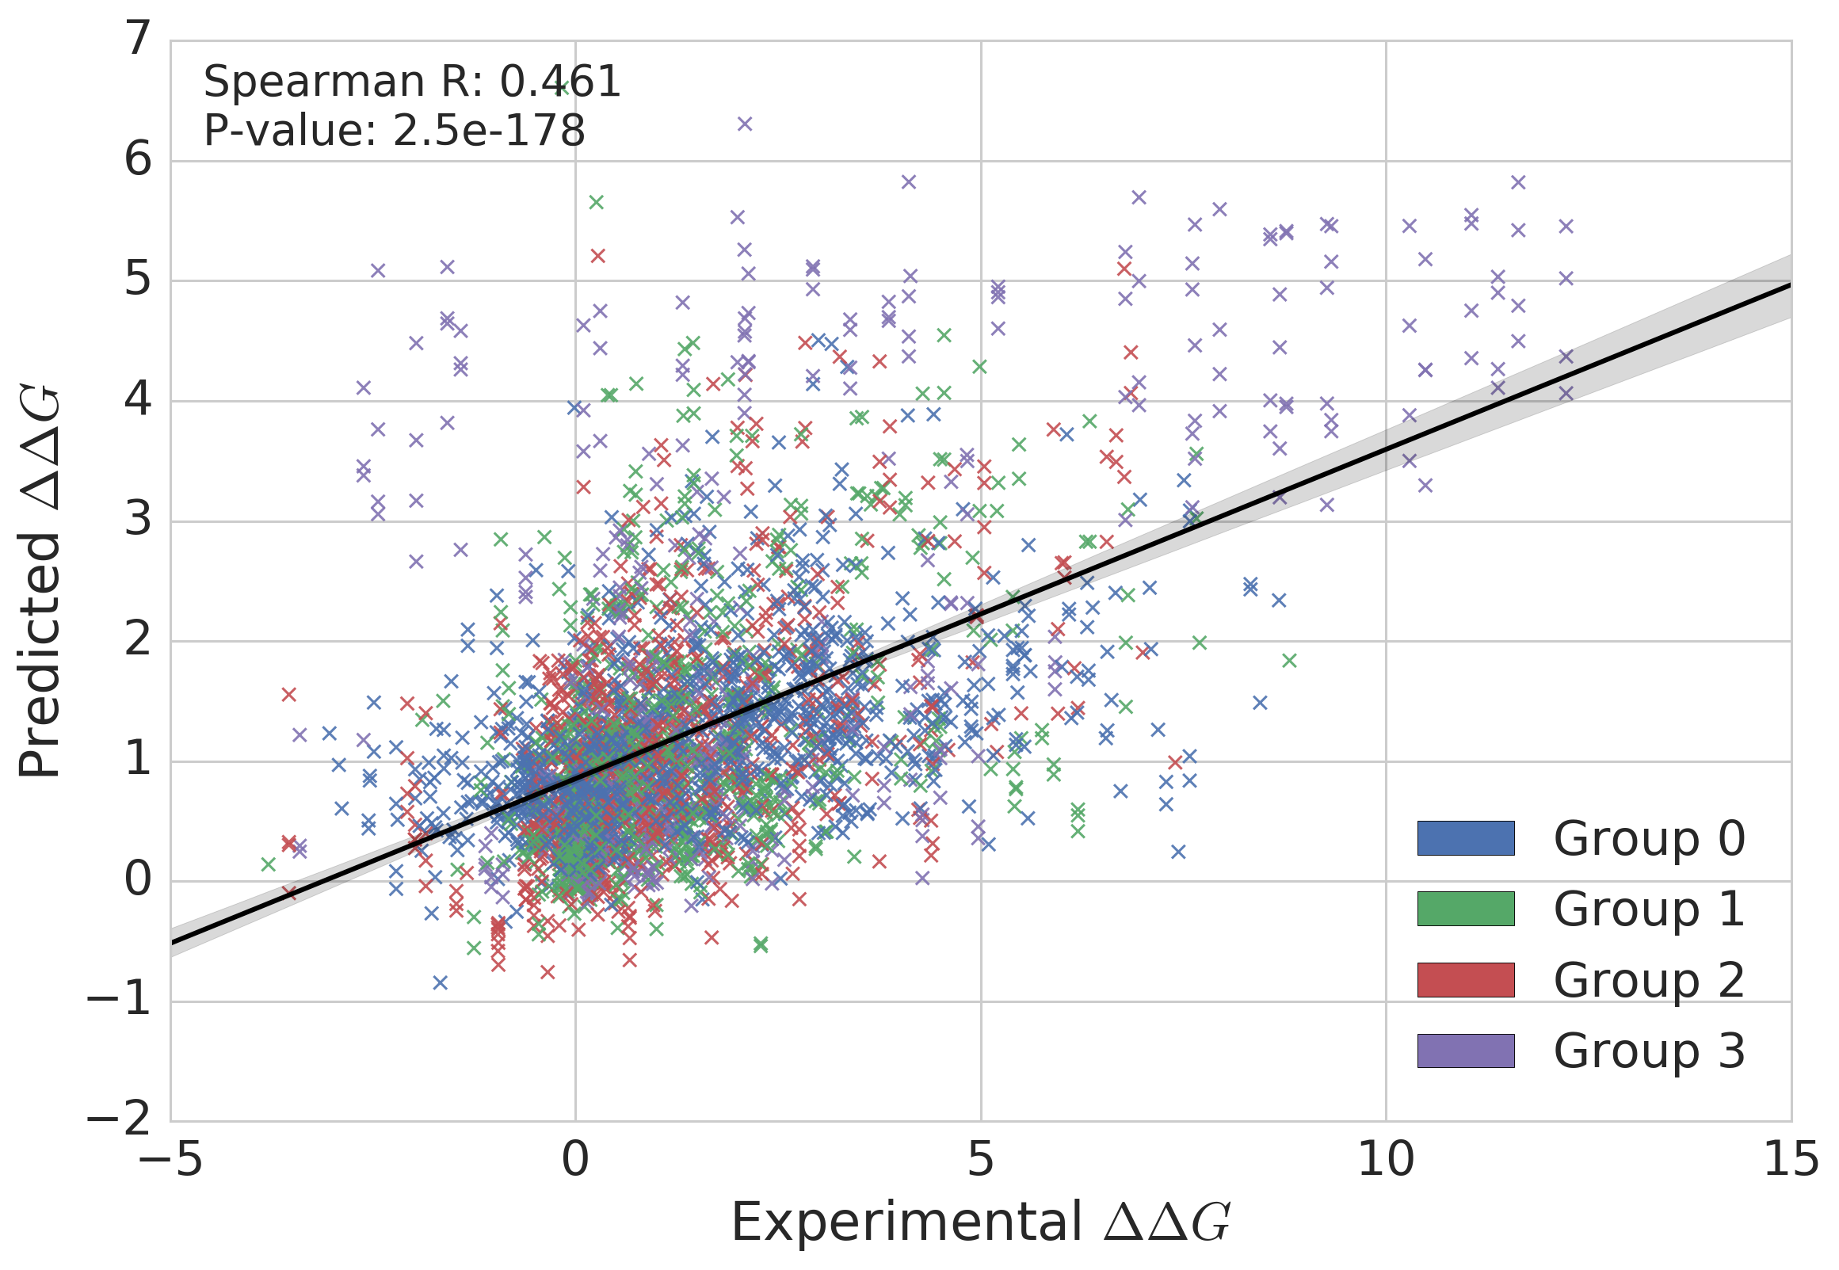
Results - Interface cross-validation

Slide 44
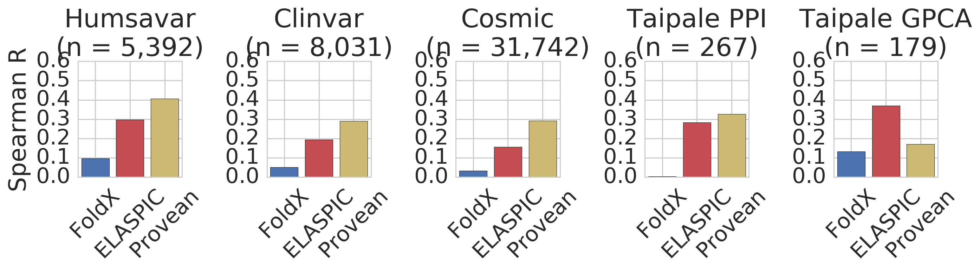
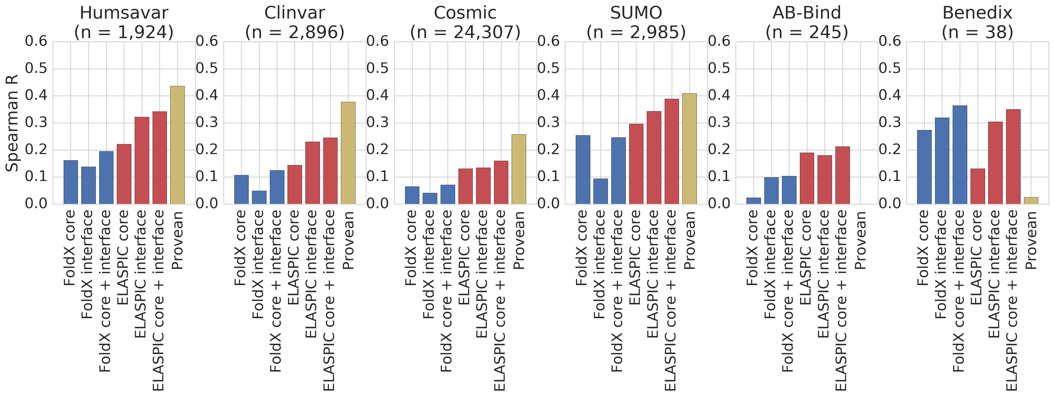
Results - Interface validation/test performance

Slide 45
Discussion

Slide 46
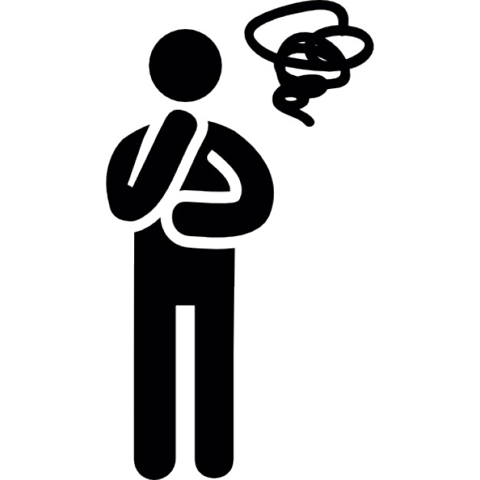
Discussion
"∆∆G' is a worse predictor of mutation deleteriousness than conservation score.
This holds true even for interface mutations.
No evidence that "edgetic' mutations are more likely to be disease causing.
Most features are not very informative.
The only dataset where we do better than Provean is AB-Bind.
...
Need to look at deleterious mutations with a small ∆∆G and benign mutations with a high ∆∆G...

Slide 47
Discussion
Don't think predicting ∆∆G on a genome-wide scale is very useful...
...until we start thinking about building a thermodynamic model of the cell?
Some features could be useful:
SASA scores
Whether or not the residue is involved in an interaction
The only dataset where we do better than Provean is AB-Bind...
Maybe there is a way to "repurpose' the project for protein design?
See future directions...

Slide 48
Future directions

Slide 49
Future directions
Better features
More training data
ELASPIC v2.0

Slide 50
Future directions - Better features

Slide 51
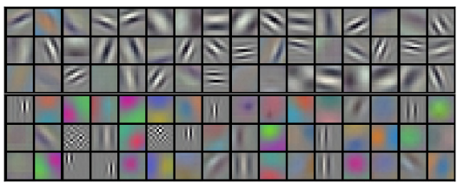
Future directions - Better features
Lessons from convolutional neural networks:
Pretrain a deep ConvNet on a large dataset (e.g. ImageNet)
Use the first layer(s) in other applications with a smaller training set

Slide 52
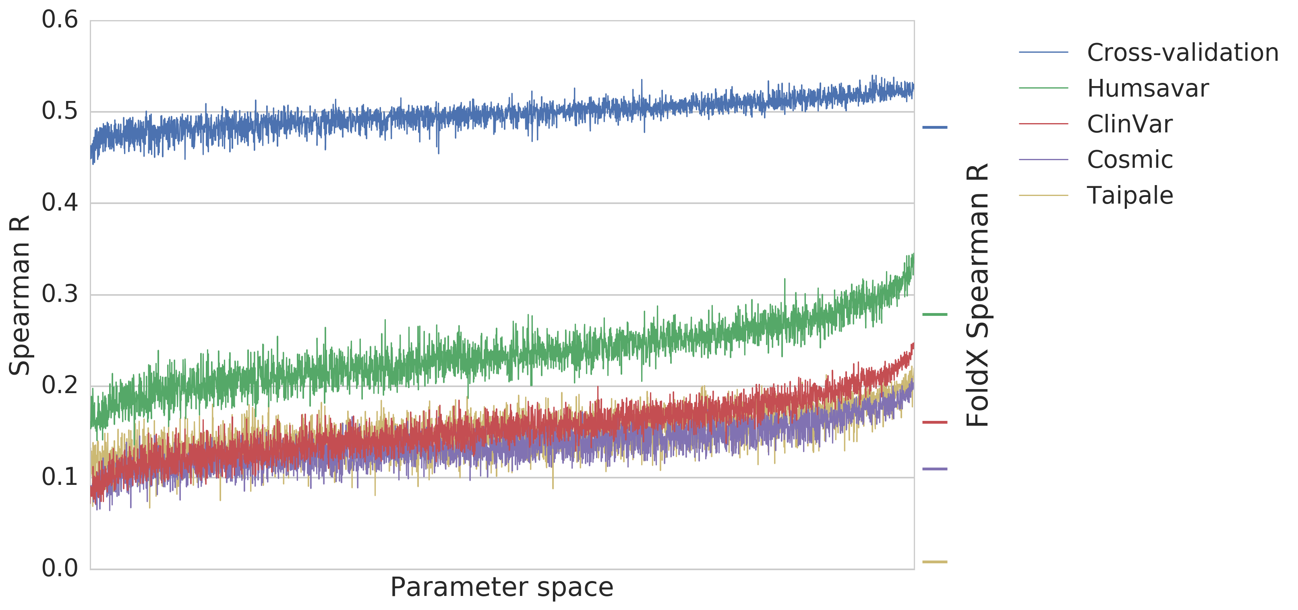
Future directions - Better features
Use the same approach for ELASPIC:
Feature extraction using a Gradient Boosting Classifier (GBC) trained to predict deleteriousness scores
With provean: learn features with better mixing of sequence and structural information?
Without provean: learn features approximating backbone wiggle in the absence of sequence information.
Logistic regression using trained GBC features as input to predict mutation.
At least good performance telling you which mutations are bad...

Slide 53
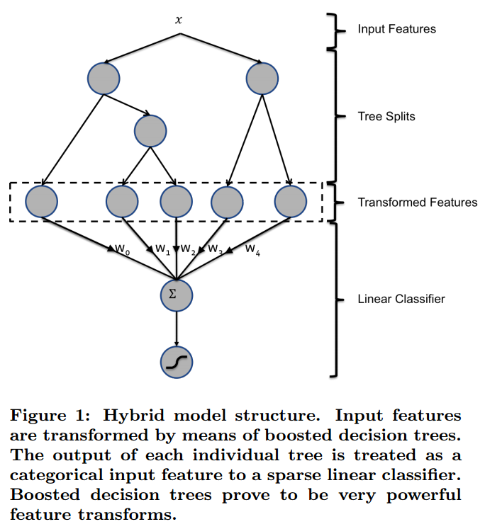
Future directions - Better features
Train to predict the deleteriousness of mutations.
Train to predict ∆∆G.
Practical Lessons from Predicting Clicks on Ads at Facebook. He Xinran et al. International Workshop on Data Mining for Online Advertising (ADKDD). August 24, 2014.

Slide 54
Future directions - More data

Slide 55
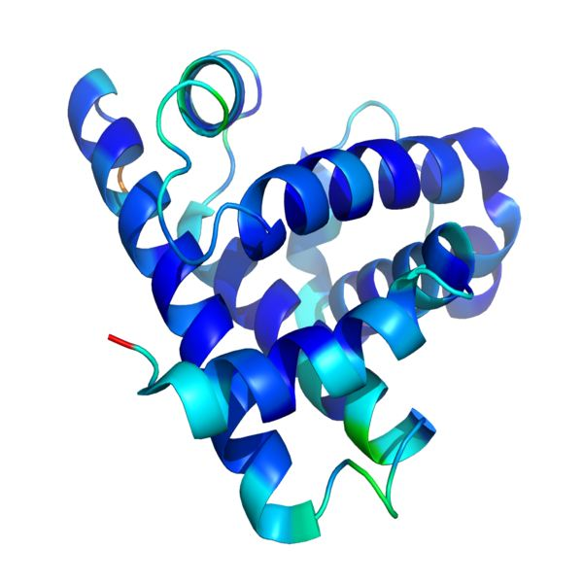
Future directions - More data
Include multi-residue mutations
Bootstrap ∆∆G scores of constituent mutations by normalizing the ∆∆G given by ELASIC by the divergence between the ELASPIC predicted and experimental values.
Normalize (divide by 2 in this case) and add to the ELASPIC training data.
1st: 3.3 kcal / mol
2nd: 2.2 kcal / mol
2nd: 1.1 kcal / mol
Actual: 3.3 kcal / mol
Total: 6.6 kcal / mol

Slide 56
Future directions - Even more data
Include other datasets following the same "bootstrap" procedure.
For the core predictor, create a dataset of mutations to thermophilic organism coming from nearest ancesstor.
For the interface predictor, convert phage-display drop-off scores to ∆∆G and add to ELASPIC training set (maybe need to log-transform or perform other correctionns).

Slide 57

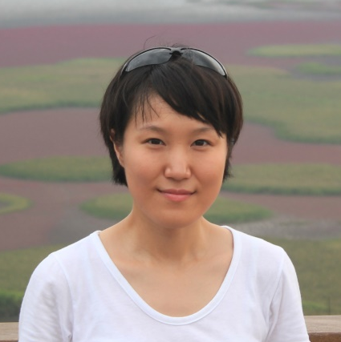
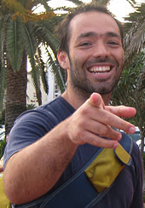
Acknowledgements
Supervisor:
Philip M. Kim
Members of kimlab:
Recep Colak
Carles Corbi
Michael Garton
Clare Juhyun Jeon
Mark Sun
Joan Teyra
Project students:
Niklas Berliner
Andres Felipe Giraldo Forero
Hanif Jetha
Sebastian Garcia Lopez
Daniel Witvliet
Clare Juhyun Jeon
Joan Teyra

